Slide 1
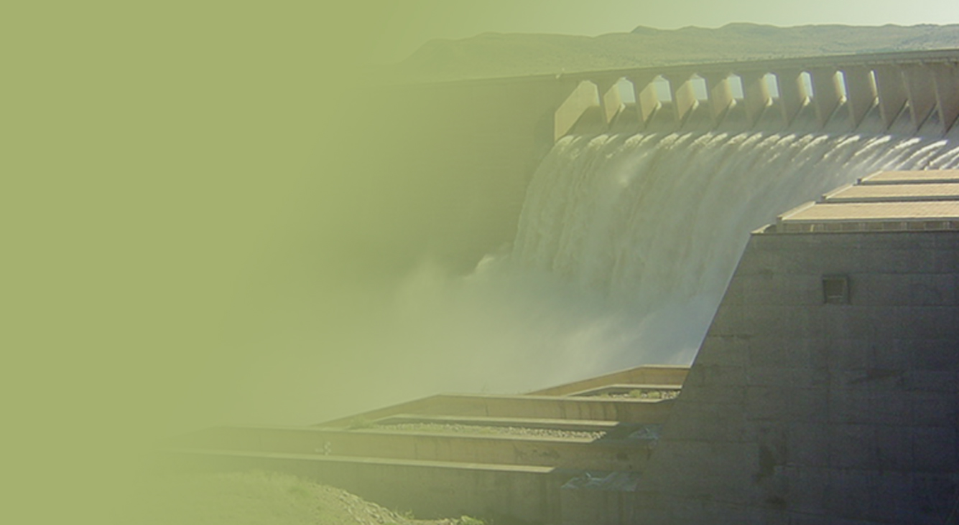
Support of the Water Reconciliation Strategy for the Algoa Water Supply System
Study Steering Committee Meeting
Aurecon
19 April 2017

Slide 2
Algoa Reconciliation Strategy

Slide 3
Objective
Algoa Reconciliation Strategy Support: To put in place arrangements and resources for ongoing implementation of the recommendations and maintenance of the Algoa Reconciliation Strategy
Evaluation of Water Use and Allocation in the OFS System: To evaluate the efficiency of the Eastern Cape Province Orange River Project
Additional Balancing Storage for NMBM: To remove potential operating system constraints for sustainable delivery of bulk Orange River water supply to the Lower Sundays River Government Water Scheme (LSRGWS) and to Nelson Mandela Bay Municipality (NMBM), for water requirements up to 2040

Slide 4
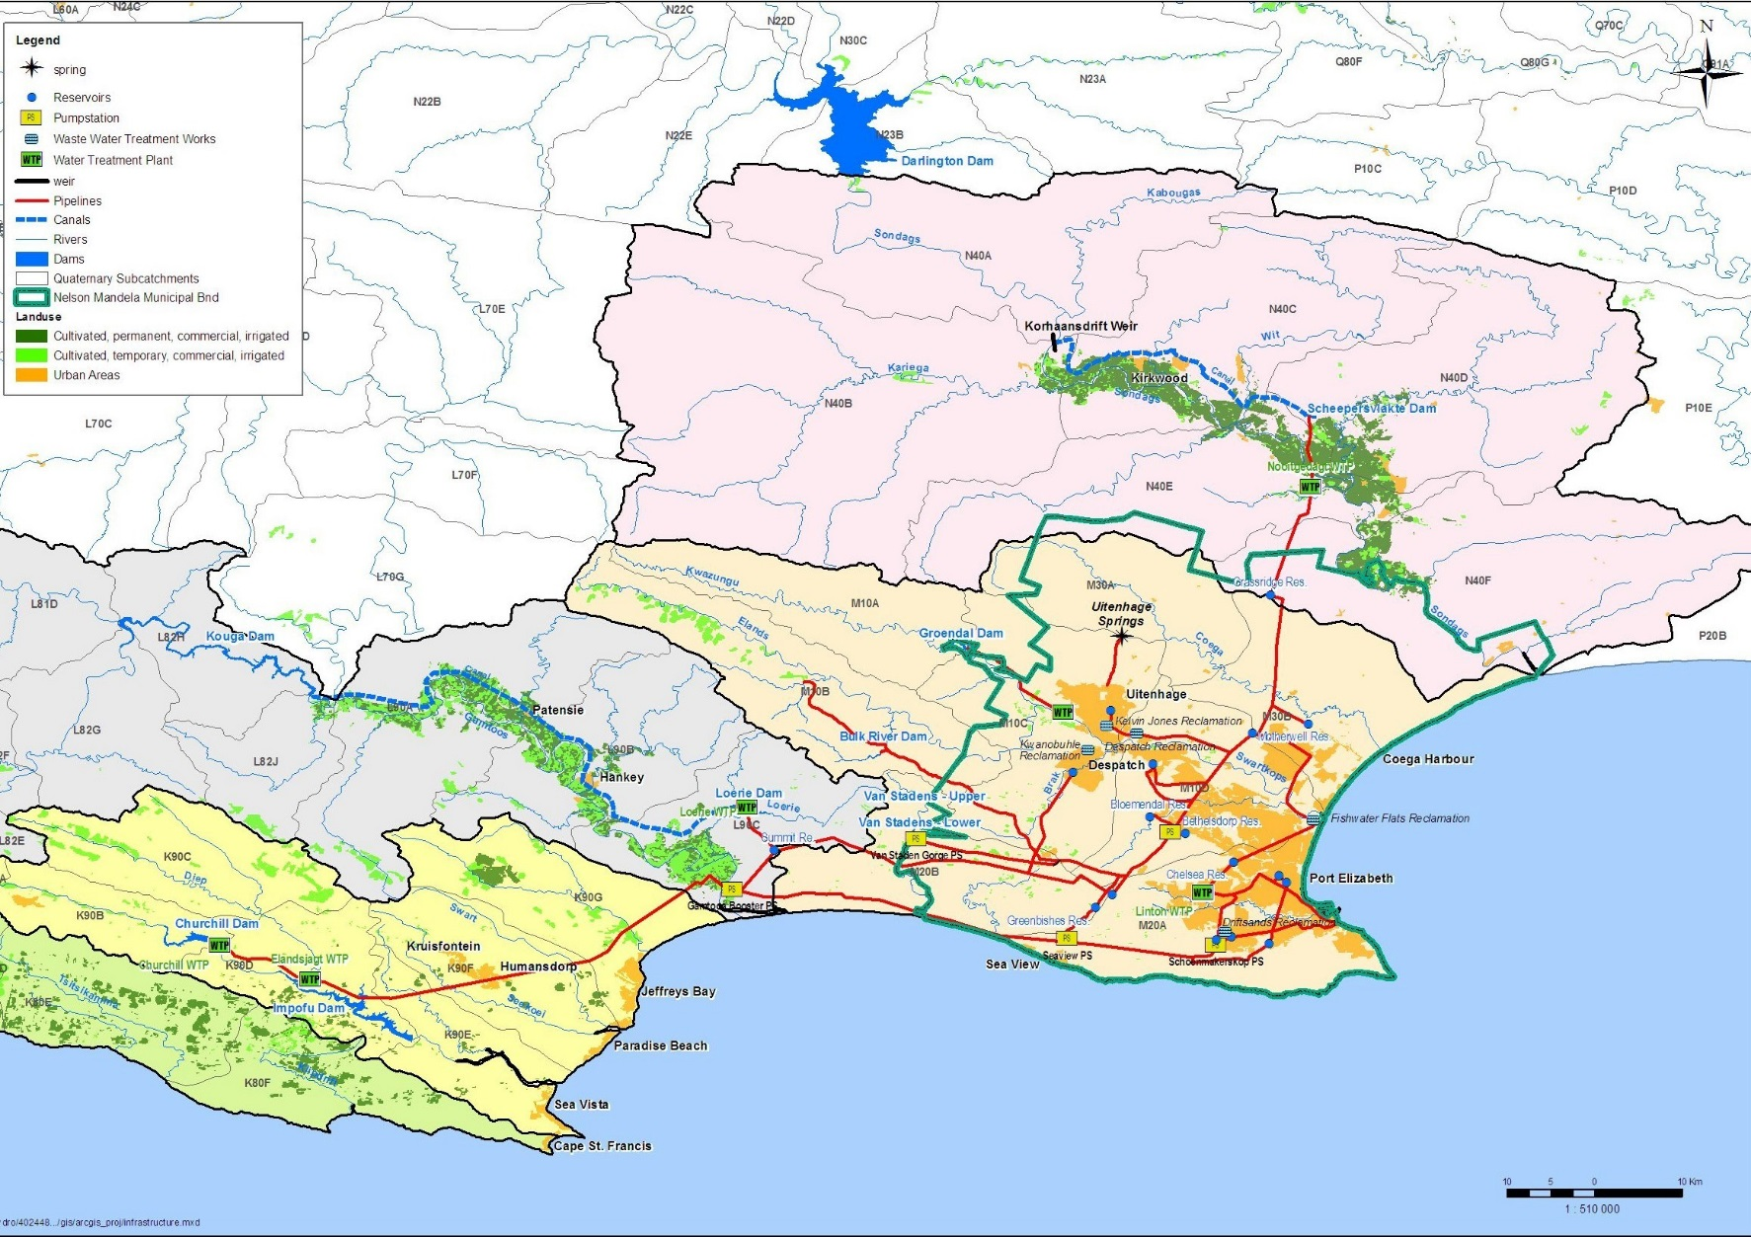
The Algoa Water Supply System

Slide 5
Strategy Implementation
Purpose: ensure long-term water balance of the Algoa WSS
Form a Strategy Steering Committee, supported by an Administrative and Technical Support Group ✓
Implement WC/WDM ✓ partially successful
Optimize operation of Kouga/Loerie system to minimise spillage at Loerie Dam ✓
DWS to undertake a Water Availability Assessment Study (WAAS) of Kouga/Loerie & Churchill/Impofu systems TOR drafted, planned for 2017/18. To be done following completion of V&V
DWS to reinvestigate dam in Kouga River On hold to assess Kouga Dam safety work to be done – now off the cards. To be reassessed.
Groundwater development Coegakop Scheme being implemented
Additional Orange River water allocated ✓ Nooitgedagt Low Level Scheme Phase 1 complete, Phase 2 almost complete, Phase 3 imminent.
Use of treated wastewater planning & design: Fishwater Flats WWTW ✓ Phase 1 Design almost complete & EIA approved, Olifantskop reservoir partially comple
Desalination of seawater ✓ Feasibility study done

Slide 6
Strategy Implementation cont.
Emergency interventions proposed due to 2009/10 drought:
Severe water restrictions ✓
Improved operation of the Kouga Loerie System ✓
Water Conservation and Water Demand Management (WC/WDM) ✓
Nooitgedagt Low-Level Scheme supplied from the Orange River ✓
Swartkops desalination of seawater discarded in favour of potential larger desalination scheme
Groundwater abstraction close to existing infrastructure ✓

Slide 7
Evaluation of Water Use and Allocation in the OFS System

Slide 8
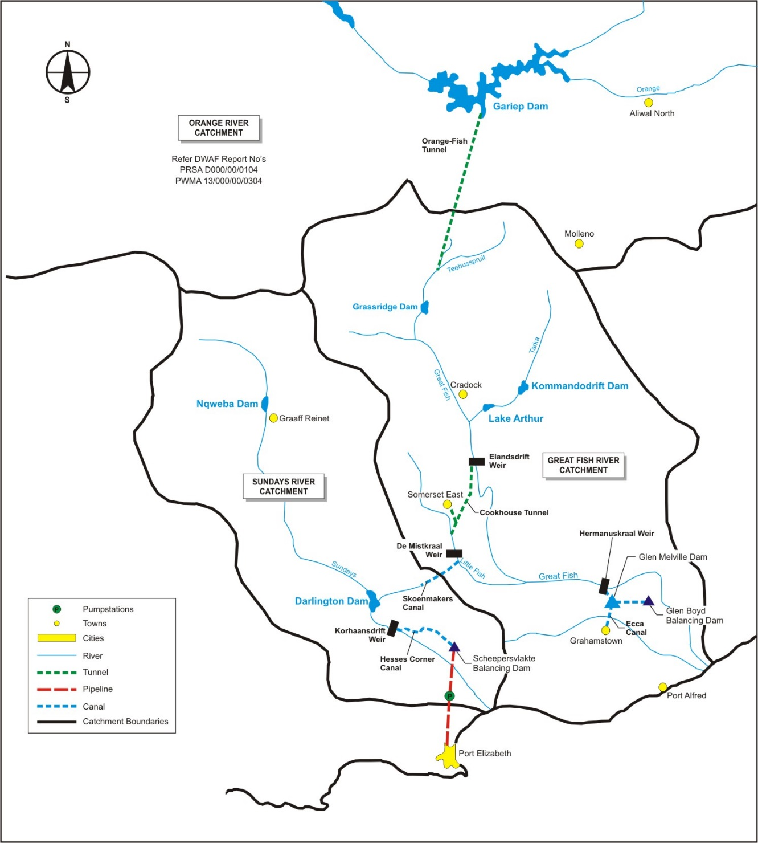
Study Area

Slide 9
Evaluation of Water Use and Allocation in the OFS System - Progress
Surface Water Hydrology & System Analysis:
Assembled WR2012 information for modelling
Updated allocations and current water requirements
Extended input data up to Sep 2015
Updated WRYM of Orange River Replanning Study & calibrated
Calibrated WQT Salinity Model to Sep 2015
Updated & extended OFS Real-Time Model (had fallen into disuse)
Long term yield analysis to be run for current operation of the system & for selected future development options &operating scenarios
Calibrated WQT configurations will be used to do first-order evaluations of salinity impacts of proposed future scenarios, including changes to operating rules
OFS Real-Time Model is being used to test WUE options

Slide 10
Irrigation Areas
The DWS irrigation areas per quaternary catchment were used
Sub-division | Irrigation Area (ha)
 | WR2012 | DWS | Difference
Groot Brak | 4,005 | 4,460 | -10%
Tarka | 1,032 | 773 | 33%
Upper Great Fish | 15,232 | 13,861 | 10%
Upper Little Fish | 2,770 | 1,910 | 45%
Middle Great Fish | 11,101 | 11,656 | -5%
Koonap | 67 | 56 | 19%
Kat | 1,868 | 2,021 | -8%
Lower Great Fish | 973 | 1,403 | -31%
Total Fish | 37,048 | 36,140 | 3%
Upper Sundays | 0 | 0 | 0%
Middle Sundays | 560 | 193 | 190%
Lower Sundays | 11,479 | 17,626 | -35%
Total Sundays | 12,039 | 17,818 | -32%
Notes:
DWS areas obtained from JM at Cradock office – divided up into quats using the shapefiles provided.

Slide 11
Evaluation of Water Use and Allocation in the OFS System - Progress
Groundwater:
Current & future borehole use by sector updated
Current use is estimated as 57 million m³/a
2040 use is estimated as 76 million m³/a
Strong growth in municipal water use (10 million m³/a)
Groundwater yield potential updated based on various regional-scale methods
Groundwater quality considered

Slide 12
Evaluation of Water Use and Allocation in the OFS System - Progress
Water Use Efficiency and Allocations:
OBJECTIVE: To identify potential savings in the use of transferred Orange River water
Evaluate overall distribution efficiency of transferred Orange River water
Consider efficiency of supply to Hermanuskraal Weir
Consider efficiencies of irrigation use
Consider efficiencies of municipal water use
Consider biofuel feedstock crops
Consider unused allocations

Slide 13
Municipal WC/WDM
Main conclusions:
General lack of pro-active WC/WDM activities
Significant water losses (47% on average)
No potential savings of allocated Orange River water through municipal WC/WDM could potentially be made available for reallocation to NMBM
Approximately 7 million m³/a of additional Orange River water allocations will potentially be required for municipal water use in the study area by 2040

Slide 14
Irrigation WUE
Approach:
Focus on WUE Options that are conducive to reallocation to alternative users/sectors (main focus for this study)
But… also identify WUE Options that are not conducive to reallocation to alternative users/sectors, that will save water
Distinguish between irrigation water supplier measures (DWS/CMAs/WUAs) and irrigation water user measures (irrigator)
Identify and describe a long-list of potential WUE Options
Screen the long-list according to agreed criteria to obtain a short-list to be investigated at a more detailed level

Slide 15
Irrigation WUE Short-list
Option | Potential savings (mill m³/a)
Lining of earth canals and storage ponds to reduce seepage losses in the GFRWUA | 18 (if 50% of canals are lined)
Improve measurement and monitoring of releases into canals to reduce overtopping | GFRWUA: 20 LSRWUA: 5
Reed clearing along river banks and aquatic weed clearing to improve river flow | Not yet quantified
Freshening allocation reduction in the lower Fish River | To be determined through modelling
Improvement in water measurement and water control structures to ensure correct allocations to irrigators | GFRWUA: 5 LSRWUA: 1
Refurbish leaking release gates at Darlington Dam in the LSRWUA | Prevent spills at Korhaansdrift Weir due to leakage - limited
P

Slide 16
WRYM: Scenario Analysis
Estimating potential volumes and sources of water that might be available to NMBM and assessing system response in WRYM
Preliminary analysis of selected scenarios:
Lining of earth canals – reduction in canal losses from current (25%) to 0%
Increasing FSC of Darlington Dam
Scenarios already configured in WRYM and analysis underway

Slide 17
Operational analysis
Elandsdrift and De Mistkraal weir operations:
A clearer understanding of freshening releases is needed to confirm estimated potential savings
Comparison between observed releases, irrigation water requests and minimum (compensation) flow requirements show that potential savings could be made
Up to 50 million m³/a at Elandsdrift
Up to 7 million m³/a at De Mistkraal

Slide 18
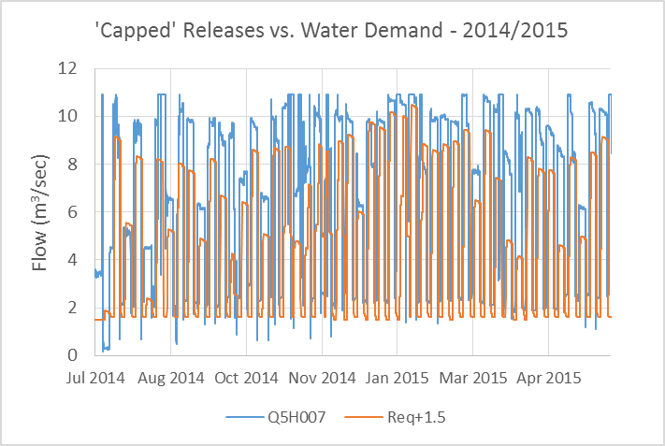
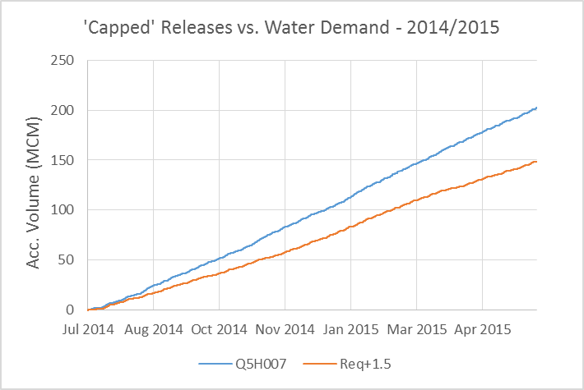
Elandsdrift: 2014 / 2015 Water Year
Minimum release often 2 m³/sec, rather than 1.5 m³/sec
In general, the release (blue line) is more than the demand + 1.5 m³/sec
Release does change with different request volumes, but often release is still too high
Accumulated difference over 1 year ~ 50 million m³/a

Slide 19
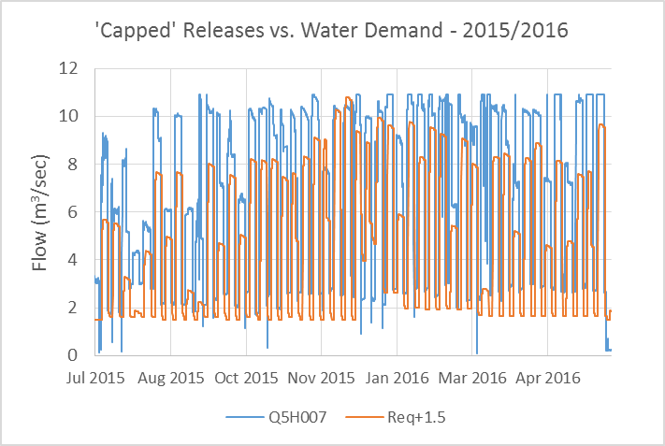
Elandsdrift: 2015 / 2016 Water Year
Similar findings compared to previous year
Again, accumulated difference over 1 year ~ 50 million m³/a

Slide 20
Additional balancing Storage for NMBM

Slide 21
Water Requirements
Compare capacity of existing bulk infrastructure with that for future requirements
Need Report from LSRWUA on licensed irrigation land and canal capacities to proceed
Need more info from WUE savings
Evaluate future water requirements of:
LSRWUA, including RPFs and some small towns receiving Orange River water
NMBM
Will make recommendation for future design capacities

Slide 22
Options considered
Retain use of existing balancing dam
Limited Raising of Scheepervlakte Dam
Construct larger dam near Scheepersvlakte Dam site
Balancing storage dam on right bank (near WTW)
Increased balancing capacity at Korhaansdrift Weir & Gravity Pipeline to WTW
Divert from Korhaansdrift Weir to small off-channel dam with Gravity Pipeline to WTW
Release water from Korhaansdrift Weir & divert downstream near WTW with Pump Station

Slide 23
Likely options to evaluate further
Limited Raising of Scheepervlakte Dam
Construct larger dam near Scheepersvlakte Dam site
While retaining the use of the existing balancing dam

Slide 24
Larger dam near Scheepersvlakte Dam

Slide 25
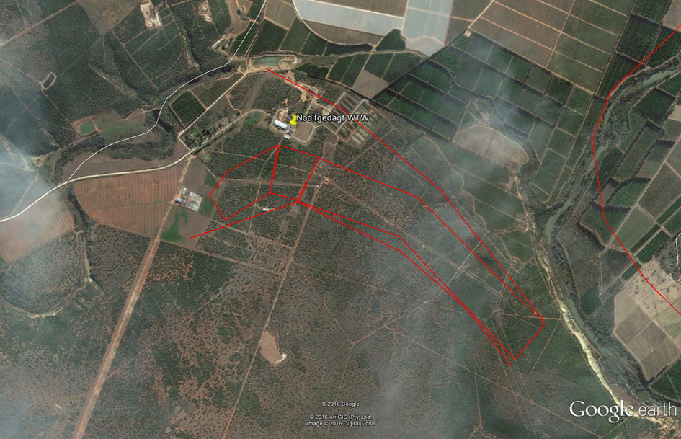
Dam at Nooitgedagt WTW
Nooitgedacht Water Treatment Works
Approximate Extent of Mudstone (T-Qg)
Approximate Extent of Proposed Dam

Slide 26
- Thank you -

